Slide 1

Computer Engineering Department
A.P. Shah Institute of Technology
G.B.Road, Kasarvadavali, Thane(W), Mumbai-400615
UNIVERSITY OF MUMBAI
Academic Year 2020-2021

Slide 2
A Mini Project Report on
Simple Social Media Platform to connect with college peers (Connecture) Submitted in partial fulfillment of the degree of
Bachelor of Engineering(Sem-IV)
in
Computer Engineering
By
Riddhi Narkar (19102003)
Shauryan Singh (19102004) Devansh Katheria (19102027) Aditya Yadav (19102006)
Under the Guidance of
Dr. Pravin Adivarekar

Slide 3
1.Project Conception and Initiation

Slide 4
1.1 Abstract
This project is based on the concept of making new and meaningful connections.
By providing access to all college peers on a single platform, getting to know peers with a similar interest can help to guide and inspire students.
We already have many sophisticated social platforms to connect with people, but, a setup at an institute-level would significantly help to bind everyone by leveraging the ability to connect digitally.

Slide 5
1.2 Objectives
To develop a rich tech culture in college.
To help college students connect and interact in a way that would lead to their skill development.
To keep every one updated about the current technical scenario and to present them with opportunities which would strengthen their vital skills in their college years.

Slide 6
1.3 Literature Review
For the development of this project, we studied different social platforms to learn and analyze their features and how to develop or improve their existing features, and also that how the people react to different versions and features of the same.
Connecture could be thought of as an amalgamation of LinkedIn and Facebook.
What makes it different, is that it would be deployed on an institute level

Slide 7
1.4 Problem Definition
Exploring new technology, knowledge, and skills is an important step to try to find a new passion or to polish an existing one. But, finding and connecting with new people who share a common interest can be a bit overwhelming at times.
We would be addressing this very issue by designing a centralized platform wherein students can build new connections and help to create an inspiring and encouraging environment to learn, develop and venture for all.
For this mini-project, we aim to develop an online social media platform at an institute level wherein students can connect with and share tech-related ideas, knowledge and help foster a rich tech culture in our college.

Slide 8
1.5 Scope
This project is will be implemented at an institute level.
The underlying idea behind this project is to increase the quality and quantity of interactions students have about technology in an institute.
The overall effect would be seen in the improving tech culture of the institute which is almost non- existent in 3 tier colleges.

Slide 9
1.6 Technology stack
Frontend
a) HTML
b) CSS
c) React.js
2) Backend
a) Express.js
b) Node.js
3) Database:- MongoDB

Slide 10
1.7 Applications
Will create a very supportive and collaborative environment for students to create communities.
Will help them to meet new people with similar interests so that they can work together to achieve a similar goal.
Can act as a medium to keep students updated with the current technical scenario.

Slide 11
1.8 Benefits for environment & Society
Due to its simple nature, it’s working is also not as complicated as other alternatives in the market, which again uses less memory and power.
Students would get access to more opportunities which would count towards their career growth.

Slide 12
2. Project Design

Slide 13
2.1 Proposed System
User will be prompted to create an account with some basic personal information. After creation of an account, the user could sign in with the username and password.
The profile of every user will be set as public for better and faster connections. Anyone can look up any other user’s profile and try to connect with them. There will be an option to setup a connection; one can try to communicate with others via the social links they provided. One can check the skills and other details of a user and try to communicate of they need any sort of guidance, etc.

Slide 14
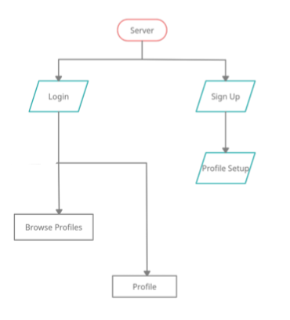
2.2 Design(Flow Of Modules)

Slide 15
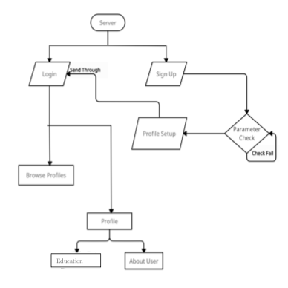
2.3 Data Flow Diagram

Slide 16
2.5 Landing Page
When a new user visits our website for the first time, or visits the website after he has logged out from his previous session, he is taken to the landing page of the website.
Either he can choose to login to his account, in case he already is a registered user of the website, or in case of a new user, he would like to register himself first, through the sign in button.

Slide 17
Register Page
All new users, or first time users must create their accounts in order to use the website.
They need to provide their name, email id, and a password for their account. They will be required to re-enter their password to confirm it, and then after hitting the submit button, an account with these credentials will be made in the backend.

Slide 18
Login Page
Registered users need to provide their password and email id while trying to login. The backend then authenticates the corresponding password to its corresponding email id and checks whether or not is valid.
If the password is valid, the user would be taken to his dashboard. If the password is invalid, then the user would be prompted to re-enter the correct password again.

Slide 19
Navbar
A navigation panel or a navbar comes handy to navigate through a website with many pages.
Before authentication, the navbar showcases the name of the website, and links to register and login pages.
After authentication, it showcases links for dashboard, students profiles and logout.

Slide 20
Dashboard
After registering, the user is asked to set up his profile.
After setting up his profile, he can add his education details. The main dashboard has all the education credential, links to add or delete a particular education credential, links to edit or delete the user’s account, and of course, the navbar.

Slide 21
User profile
Every user profile is displayed to all the users of the platform.
It has the details of the user, like name, year of engineering, educational credentials, skill set and some other social site links for others to connect with.

Slide 22
3.Implementation

Slide 23
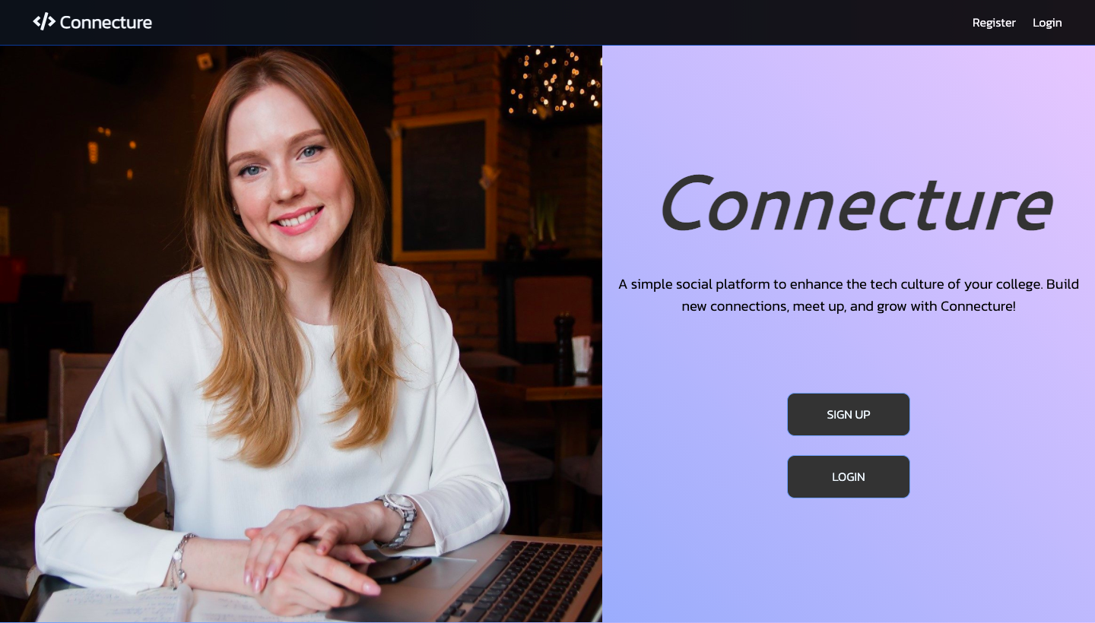
3.1

Slide 24
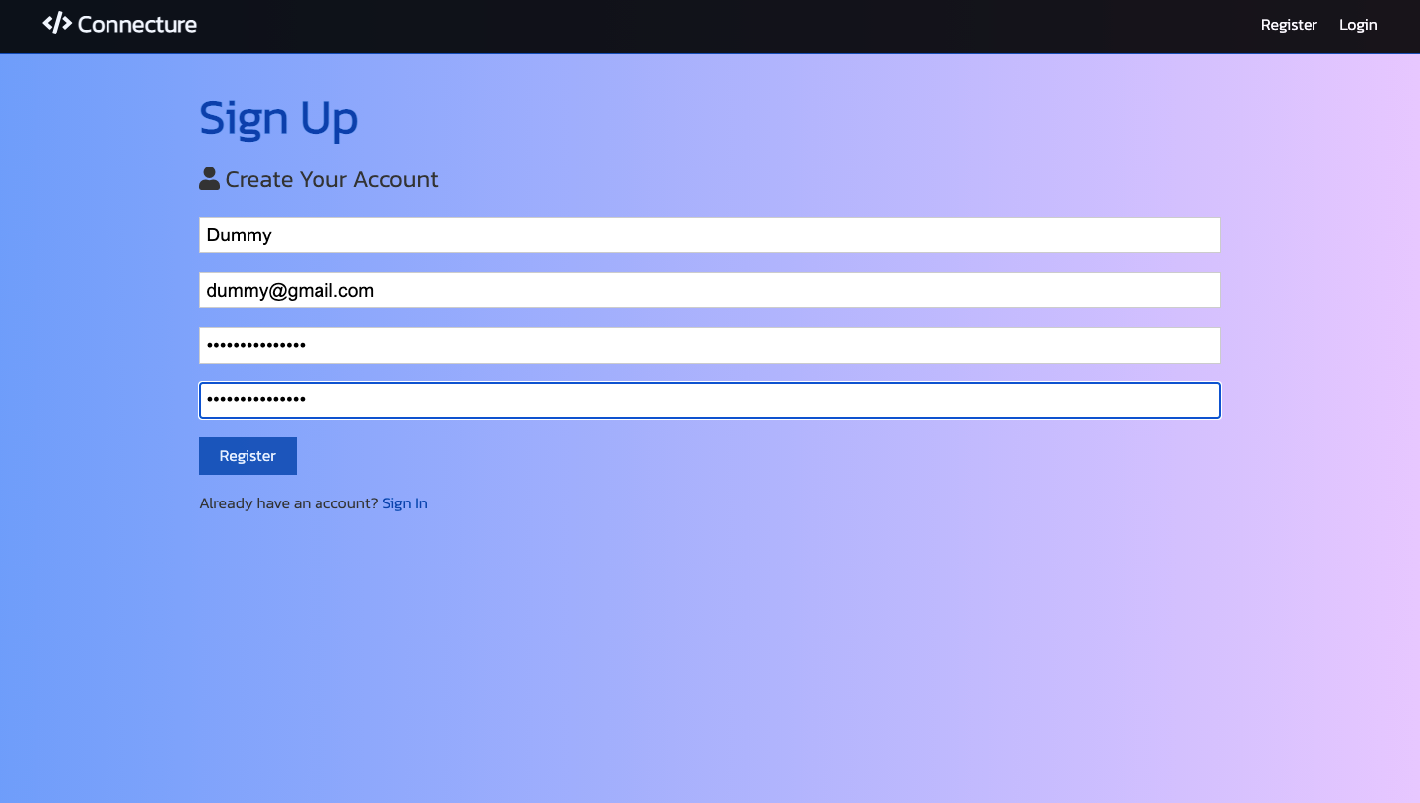

Slide 25
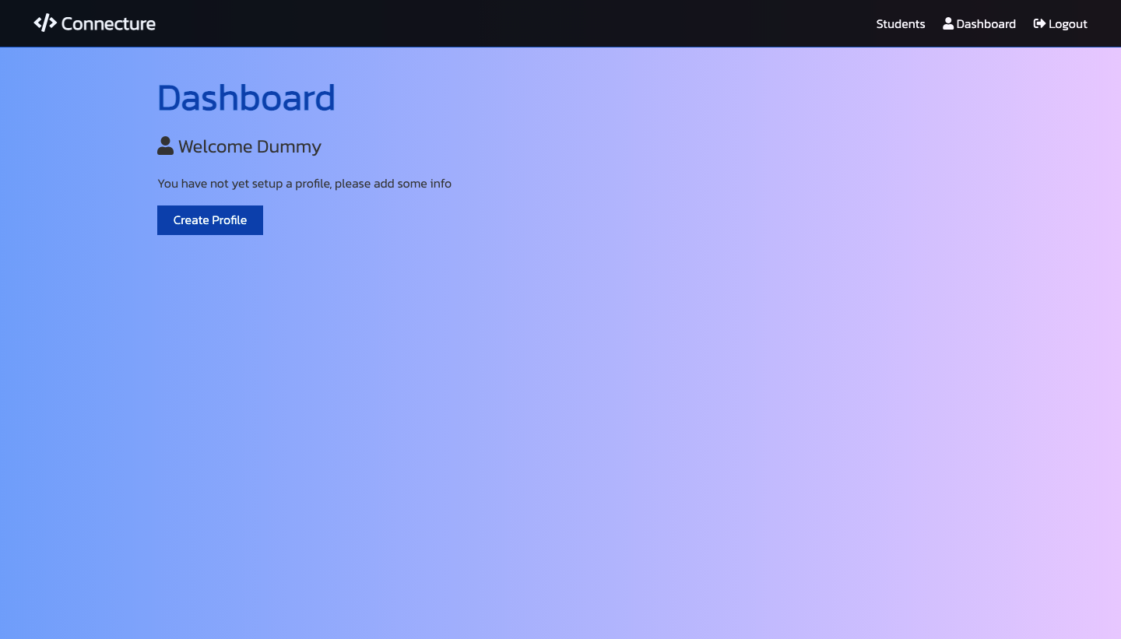

Slide 26
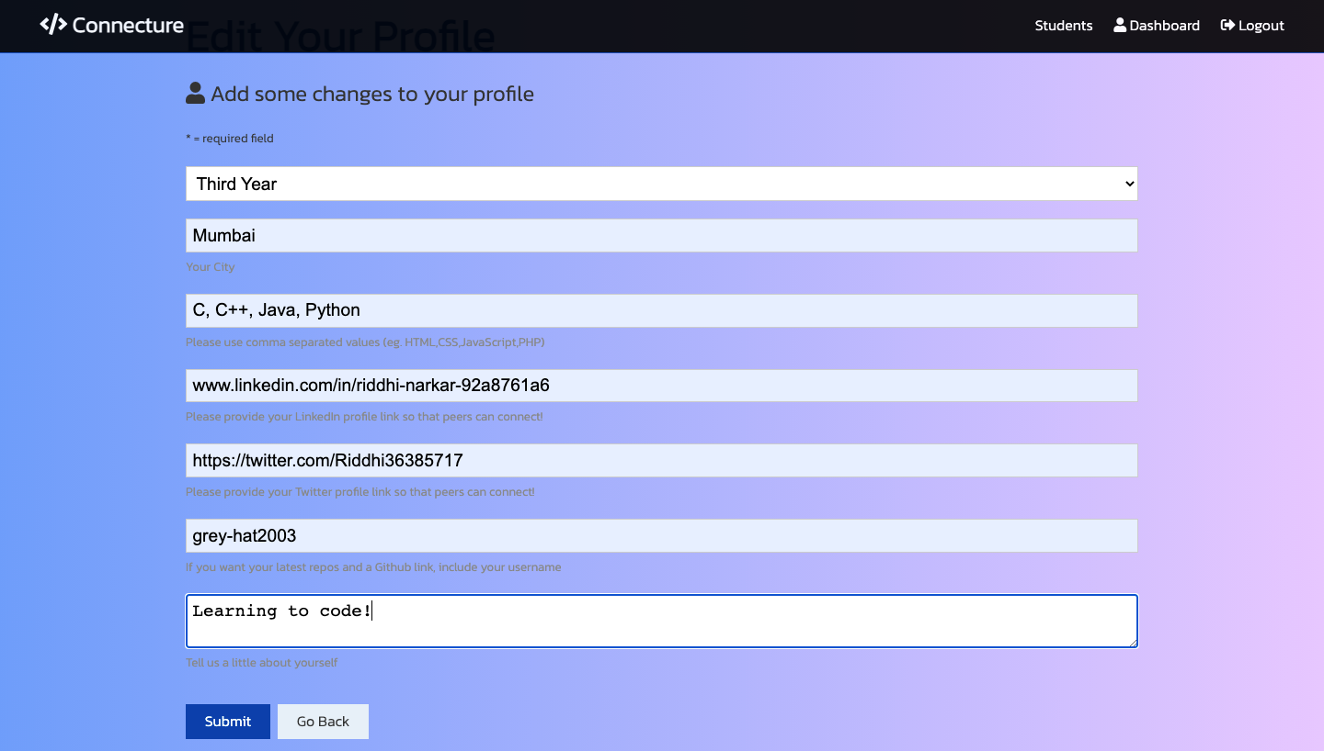

Slide 27
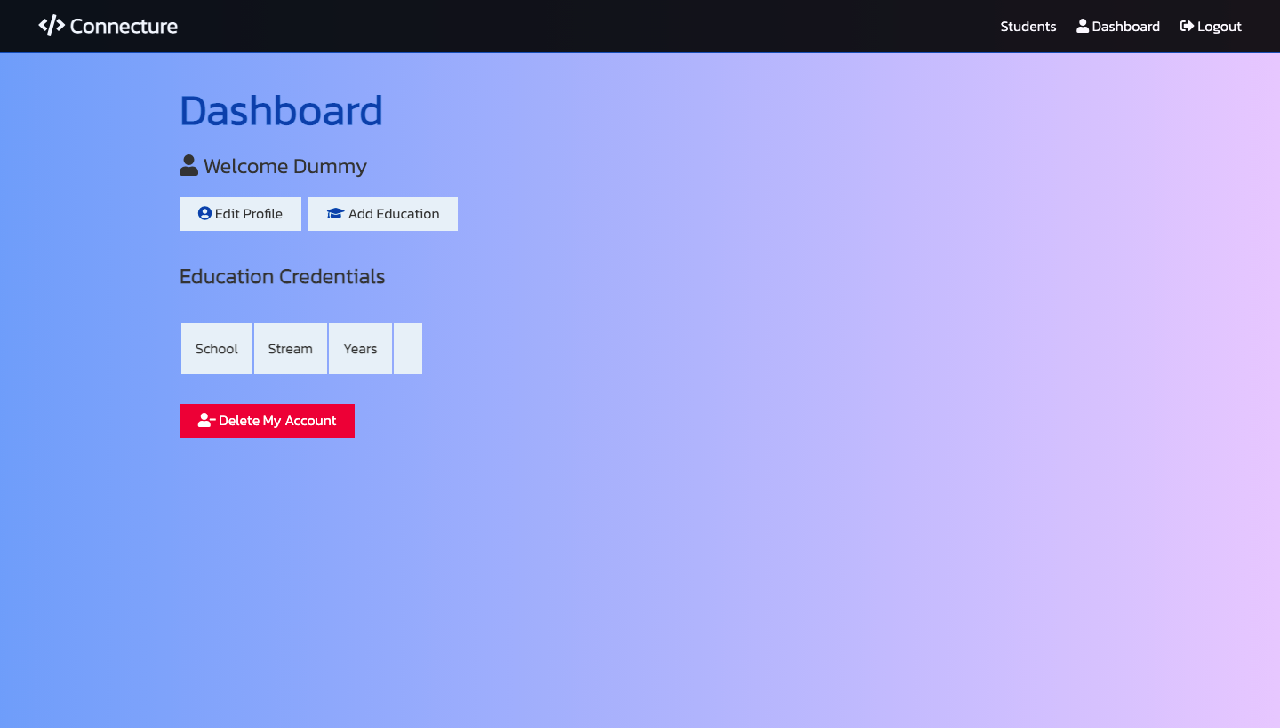

Slide 28
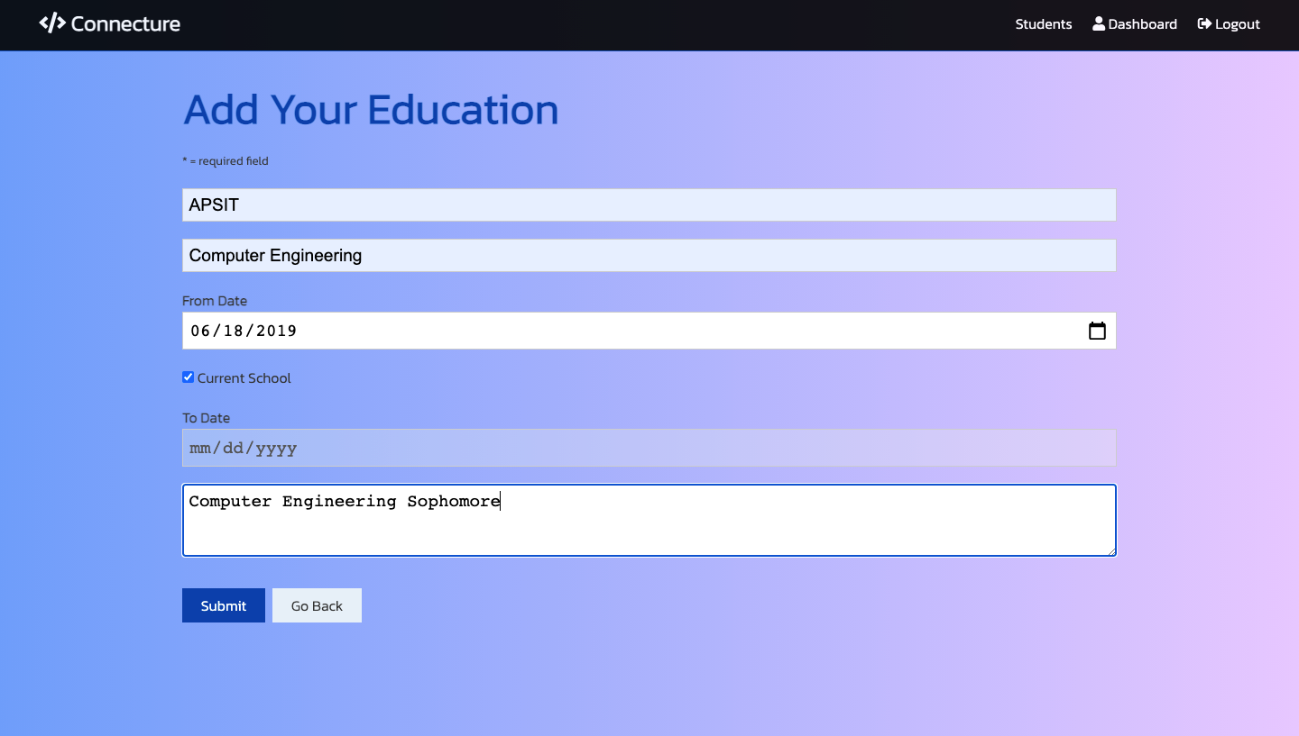

Slide 29
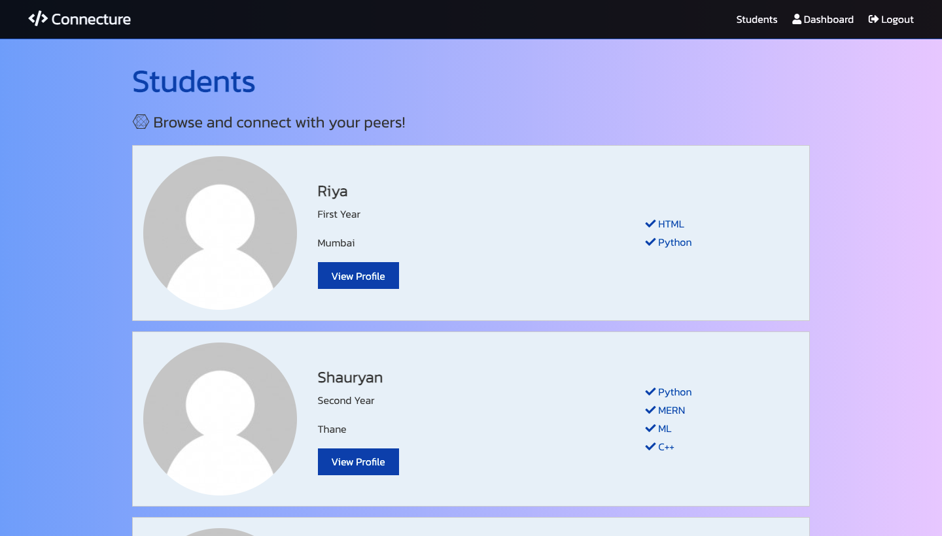

Slide 30
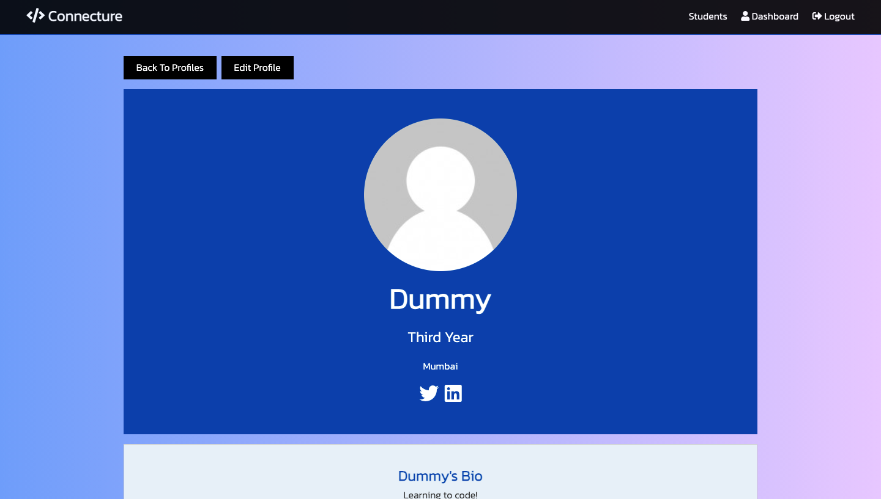
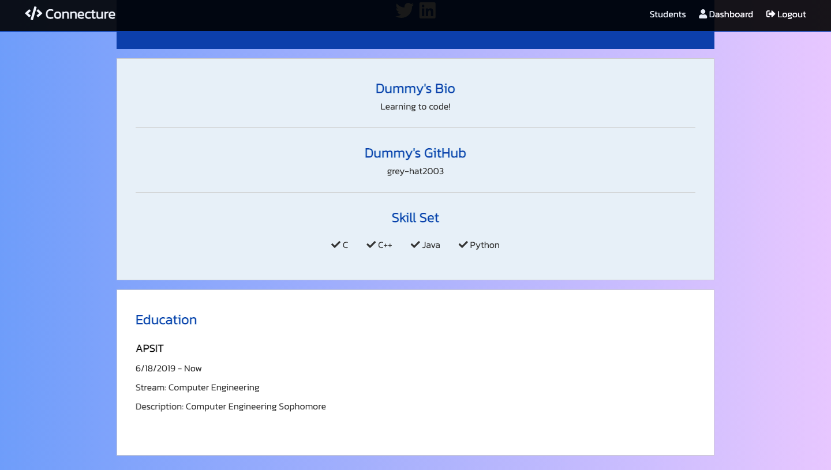

Slide 31
4. Results
Connecture helps in making the common knowledge of a tech group wider. Facts, news and other events could be circulated and shared with a very good level of efficiency using such a service. Such fast sharing of information makes the students aware of the technical scenario of the industry.
Connecture can have a strong impact on the learning and development of a student with the help of his peers and help him find his passion and excel in his field with making and build and maintaining a strong tech culture supported by healthy connections.

Slide 32
5.Future Scope
Posts could be a fun way for users to connect on a deeper level on Connecture.
An inbuilt chat feature would enhance faster connections.
Notifications would help to keep updates organized.

Slide 33
6. References
Codevolution,“ReactJSTutorialforBeginners”,YouTube play list for beginners learning React
Aman Dhattarwal: Apni Kaksha, “World’s most premium web development course: From beginners to Advance level”, YouTube playlist for learning web development
MaterialDesign,“A guide to dark theme UI and its colour scheme”
W3Schools, “CSS and Flexbox”
W3Schools, “Styling React using CSS”
Medium,“Four ways to style React components”Author-Agath Krzywda, Medium Group: Codeburst.io
Sarah L. Fossheim, “How to add a gradient overlay to text with CSS”

Slide 34
References
Stack Overflow, “How to use Google fonts in React.js?”
Flavio Copes, “Validating input in Express using express-validator”
C# Corner, “CRUD operations using React, Nodejs, Express, MongoDB”
zalmoxisus - GitHub, “Redux Dev tool extension”

Slide 35
Thank You

